Slide 1

Victorian City Council Model Budget 2014/15
A Best Practice Guide
Local Government Finance Professionals
Annual Conference
28 February 2014
Bruce Dobson CA, Chair ICAA Local Government Taskforce

Slide 2

What is the model budget?
Heading Style
Best practice guide
Framework for preparing a budget
Financial management guidance
Based on real life examples
Attempts to balance needs of all users
Body copy
> Bullet style
Notes:
For the benefit of our interstate visitors and those who are new local government…
The Model Budget is a best practice guide which provides a framework for preparing local government budgets.
It includes commentary on a range of financial management issues including advice on their treatment in a local government context and real life examples.
Its overall objective is to balance the needs of all users – community, key stakeholders, councillors and officers

Slide 3
Who is on the taskforce?
Bruce Dobson (Boroondara/Chair)
Kevin Adams (McLean Delmo)
Joella Gould (UHY Haines Norton)
Rob Wernli (DFK Collins)
Helen Sui (Moreland/FINPro)
Lucy Roffey (Mount Alexander/FINPro)
Portia Branton (Bayside/LG Pro)
Allan Holmes (MAV)
Martin Thompson (Model Accounts link)
Notes:
The ICAA Taskforce has met since 2001 and is charged with the responsibility of updating the model budget. – BIG THANKS
We have a relatively even mix of professionals and practitioners on the taskforce as well as peak body representatives. We have also tried to have practitioners representing both urban and rural Councils.
So let’s have a look at the contents and major changes for the new Budget Guide.

Slide 4

What is in the Guide?
Structured in four layers
Introduction and summary (Mayor; CEO)
Overview (links to Council Plan; services; budget influences)
Budget analysis (financial statements)
Long term strategies / information
+ Appendices (more details and disclosures)
+ Commentary

Slide 5
Act and Regulation changes
Updated compliance checklist

Slide 6
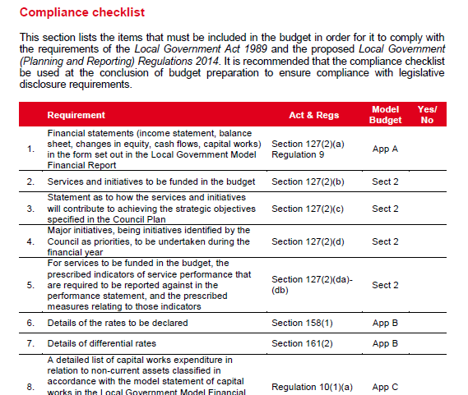

Slide 7
Act and Regulation changes
Updated compliance checklist
Planning and accountability framework

Slide 8
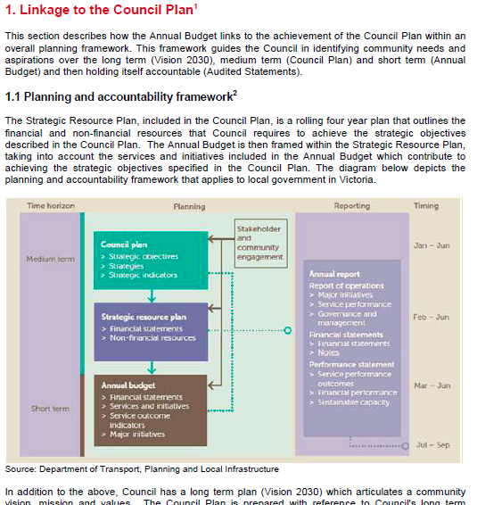

Slide 9
Act and Regulation changes
Updated compliance checklist
Planning and accountability framework
Services, initiatives and service performance indicators

Slide 10
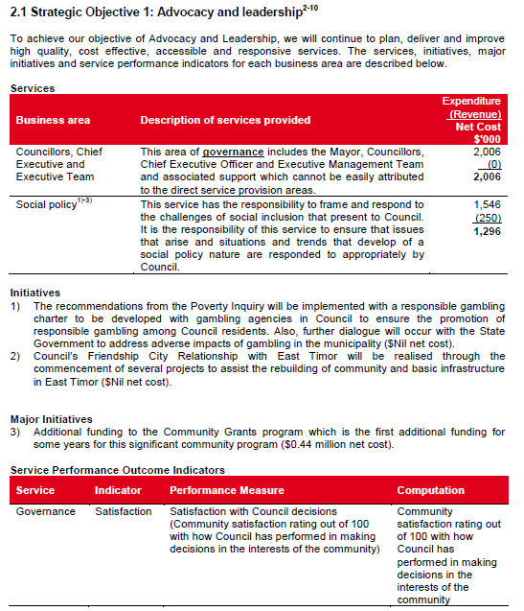
Notes:
Wide variation
50 ‘standard’ income statement
30 ‘alternative’
Some both (and some more than 2)
Lots of variations in the alternative format statement
Some sought to include a mix of income statement and cash flow (or dare I mention it, rate determination)
Taskforce view
see commentary to standard statement section
think carefully about what items are highlighted separately and how disclosed – alternative model has clear sub-totals
conclude with the ‘comprehensive result’ – ie. Bottom line the same as what will be reported in the annual financial statements income statement
be careful not to present a result that is contradictory to the annual financial statements

Slide 11
Act and Regulation changes
Updated compliance checklist
Planning and accountability framework
Services, initiatives and service performance indicators
Adjusted underlying result

Slide 12
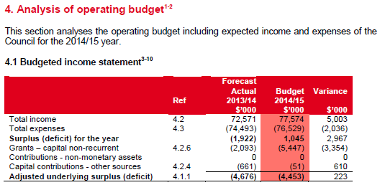
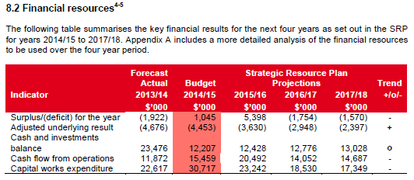

Slide 13
Act and Regulation changes
Updated compliance checklist
Planning and accountability framework
Services, initiatives and service performance indicators
Adjusted underlying result
Restricted cash / unrestricted cash

Slide 14
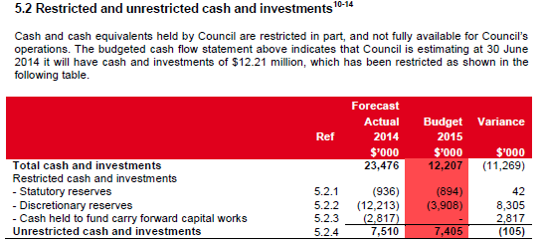

Slide 15
Act and Regulation changes
Updated compliance checklist
Planning and accountability framework
Services, initiatives and service performance indicators
Adjusted underlying result
Restricted cash / unrestricted cash
Financial performance indicators

Slide 16
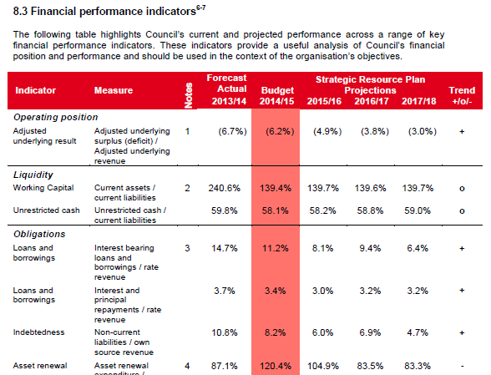

Slide 17
Act and Regulation changes
Updated compliance checklist
Planning and accountability framework
Services, initiatives and service performance indicators
Adjusted underlying result
Restricted cash / unrestricted cash
Financial performance indicators
Human resources

Slide 18
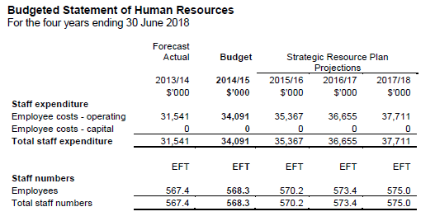

Slide 19
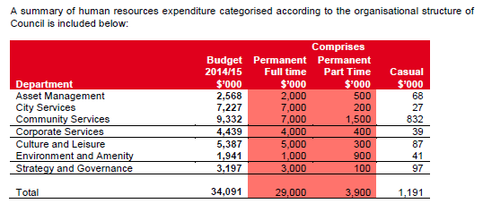
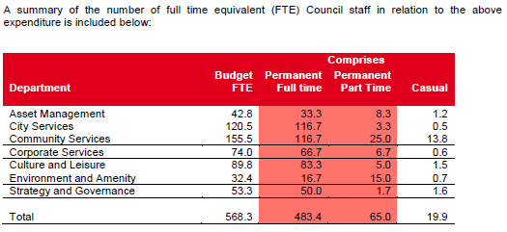

Slide 20
Act and Regulation changes
Updated compliance checklist
Planning and accountability framework
Services, initiatives and service performance indicators
Adjusted underlying result
Restricted cash / unrestricted cash
Financial performance indicators
Human resources
Capital expenditure

Slide 21
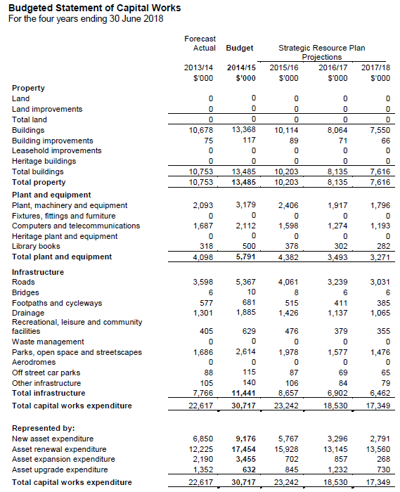

Slide 22
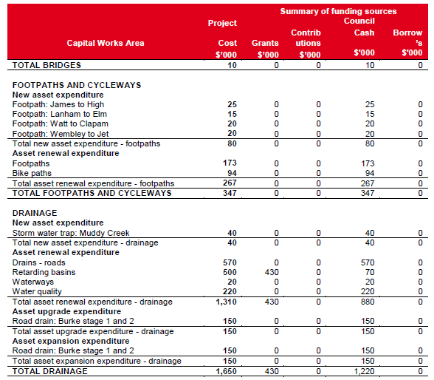

Slide 23
Act and Regulation changes
Statement of changes in equity

Slide 24
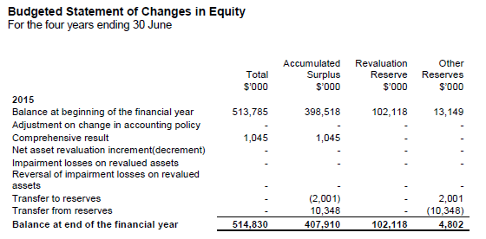

Slide 25
Act and Regulation changes
Statement of changes in equity
Rates and charges section

Slide 26
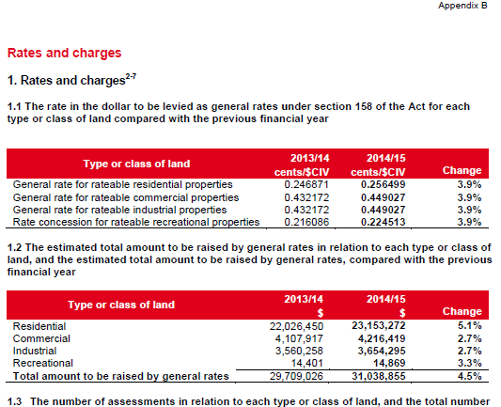

Slide 27
Other changes
No alternative format income statement
No Statement of Investment Reserves
Financial Statements mirror Model Financial Report form
Updated disclosure for topical events (eg DB super)

Slide 28
‘Draft’ Model Budget
Heading Style
Body copy
> Bullet style
Reflects Act and Proposed Regulations
Worked closely with DTPLI to ensure compliance with new requirements
Public submission process – Regulations may change – you need to monitor this closely
Final Model Budget to be issued after Regulations are settled

Slide 29
What is available?
Officers
Full document including commentary (26 February)
Emailed to FinPro members and on FinPro website
Coming soon:
Templates (Word / Excel)

Slide 30
What is available?
Mayors and CEOs
Hard copy report (after Regs settled)
Mailed out from MAV (April / May)
Extra copies available from MAV and/or Institute

Slide 31
Victorian City Council Model Budget 2014/15
A Best Practice Guide
Local Government Finance Professionals
Annual Conference
28 February 2014
Bruce Dobson CA, Chair ICAA Local Government Taskforce

